Slide 1

Wolt Data Analysis Presentation

Slide 2

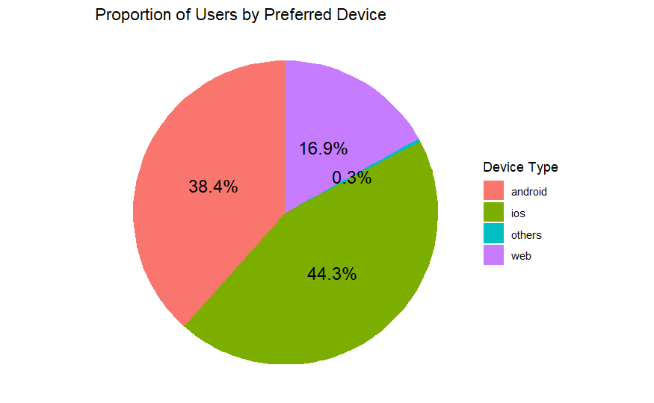



Proportion of Users by Preferred Device
- 44.3% of users use iOS devices
- 38.4% of users use Android devices
- 16.9% of users use Web devices (PC)
- 0.3% of users use other devices.

Slide 3



How Device Preference Drives iOS, Android and Web Purchases
Device Loyalty:
- iOS: 94.6% on iOS
- Android: 92.3% on Android
- Web: 62.5% on the Web
Preferred Device | User Count | Total iOS Purchases | Total Web Purchases | Total Android Purchases
iOS | 9,747 | 30,019 | 1,134 | 563
Android | 8,448 | 934 | 983 | 22,967
Web | 3,715 | 3,934 | 10,590 | 2,416
Grand Total | 21,983 | 34,887 | 12,708 | 25,946
Purchasing Activity:
- iOS: 3.08 purchases/user
- Web: 2.85 purchases/user
- Android: 2.72 purchases/user
Cross-Device Purchasing:
- iOS and Android: 5-7% buy on non-preferred devices.
- Web: 3,934 iOS and 2,416 Android purchases.
*removed ‘Others’ as it contains negligible data
Suggestions
- Focus on mobile optimization for iOS & Android due to high loyalty.
- Cross-Device: Seamless experience (e.g., synced accounts, consistent UI) could boost purchases.

Slide 4
Purchasing User Insights: €2.1M across 19 countries
Countries with Purchases | Purchasing Users | Total Purchase (€) | Avg. Purchase Value (€) | Valid Payment Method | No Valid Payment Method
19 | 12,028 | 2.12M | 31.20 | 7,117 | 4,911
Strategic Takeaways
- Expand Reach: Only 19/59 countries (32%) have purchases – target the remaining 40 with tailored campaigns in local language.
- Fix Payment Barriers: 41% of users (4,911) lack a payment method – simplify payment setup & add more options.
- Maintain/Increase Avg. Purchase Value: Encourage users to spend more per transaction - recommend related products or free shipping.
- Loyalty Programs: Reward repeat purchases with points, discounts & exclusive offers to encourage users to spend more.

Slide 5
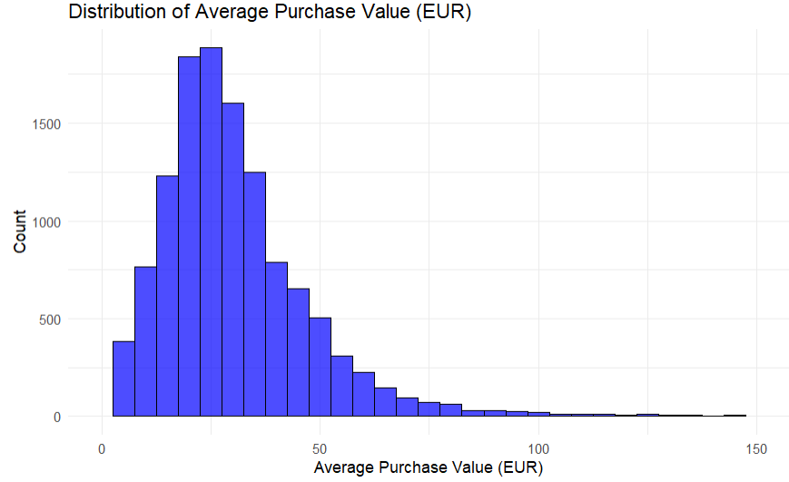
Avg. Purchase Value Distribution
Key Takeaways
- Low Spenders Dominate: Most users' average €0-€20, below the €31.20 mean.
- High Spenders Add Value: Few users exceed €100 – retain & upsell to these users.
- Upsell Opportunity: Push low spenders to increase spending via bundles or subscriptions.

Slide 6
Converting Non-purchasing Users
Non-purchasing Users | Valid Payment Method | No Valid Payment Method
9,955 | 451 | 9,504
Strategic Takeaways
- Boost Engagement: Target the 451 users with payment methods using re-engagement campaigns & personalized offers.
- Provide Immediate Guidance: Reduce onboarding friction with in-app tutorials & tooltips to guide first actions.
- Investigate Browsing Behaviour: Analyze app usage duration to identify users waiting for better deals.

Slide 7

Purchase Trends by Store-type
Insights
- Restaurant purchases dominate at 60.77%, making them the largest category.
- Retail-store and Grocery together account for 37% of purchases.
- General-merchandise and Pet-supplies are niche, contributing less than 2.5% combined.
Takeaway
- Focus marketing efforts on Restaurant partnerships
- Explore growth opportunities in Retail & Grocery sectors.

Slide 8
User Purchase Behaviour by Store-type
Insights - All purchasing users have purchased from restaurants.
- Around 12- 15% of purchasing users have purchased from General Merchandise, Grocery & Retail Store.
- 1.45% of purchasing users purchased from Per Supplies
Takeaway
- Volt is most associated with finding restaurants, with it being fully utilised.
- While General Merchandise, Grocery & Retail Store utilisation is somewhat lacking.

Slide 9

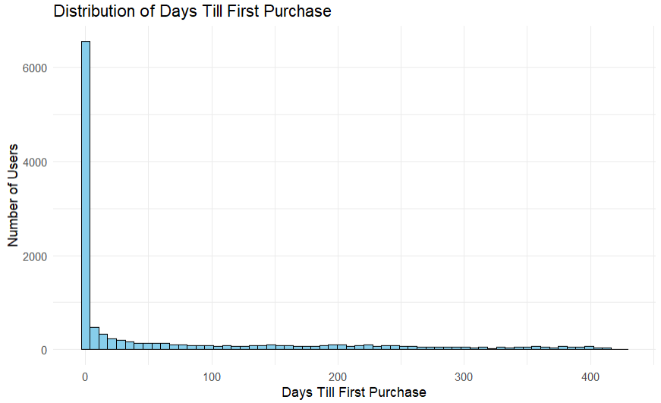


Time to First Purchase (From Registration Date to First Purchase Date)
Insights
- Min: 0 days
- Median: 1 day
- Mean: 68.4 days (far from the median)
- Max: 424 days (over a year)
Takeaways
- Most users purchased within the first week
- A smaller group of users take significantly longer.
*each bar represents 1 week
Suggestion
- Consider targeted re-engagement strategies

